Slide 1
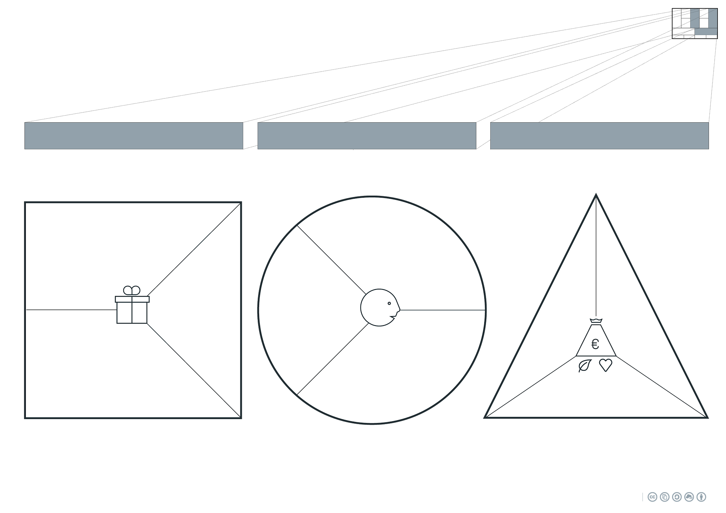
Helping solve the problem of the increasing heavy rain.
Gathering data of the quantity of gathered rain.
Customers are paying for the materials and the know- ledge that they a contributing to a bigger cause.
They are aware of the different types of water containers for in the garden/balconys.
These customers are aware of material circulation.
...
Applications:
...
Money
Geological/water data
⧠ Product
⧠ Service
⧠ Certification
⧠ Training
⧠ Maintenance
⧠ ...
...
...
Accessibility
Convenience
Ease of use
Sustainability
Direct sales
Subsidy
Later
Subscription
Selling Data
B2B: Housing Corporations, small garden businesses.
B2C:
Consumers who are/want to be aware of the rainwater/ material circulation.
...

Slide 2
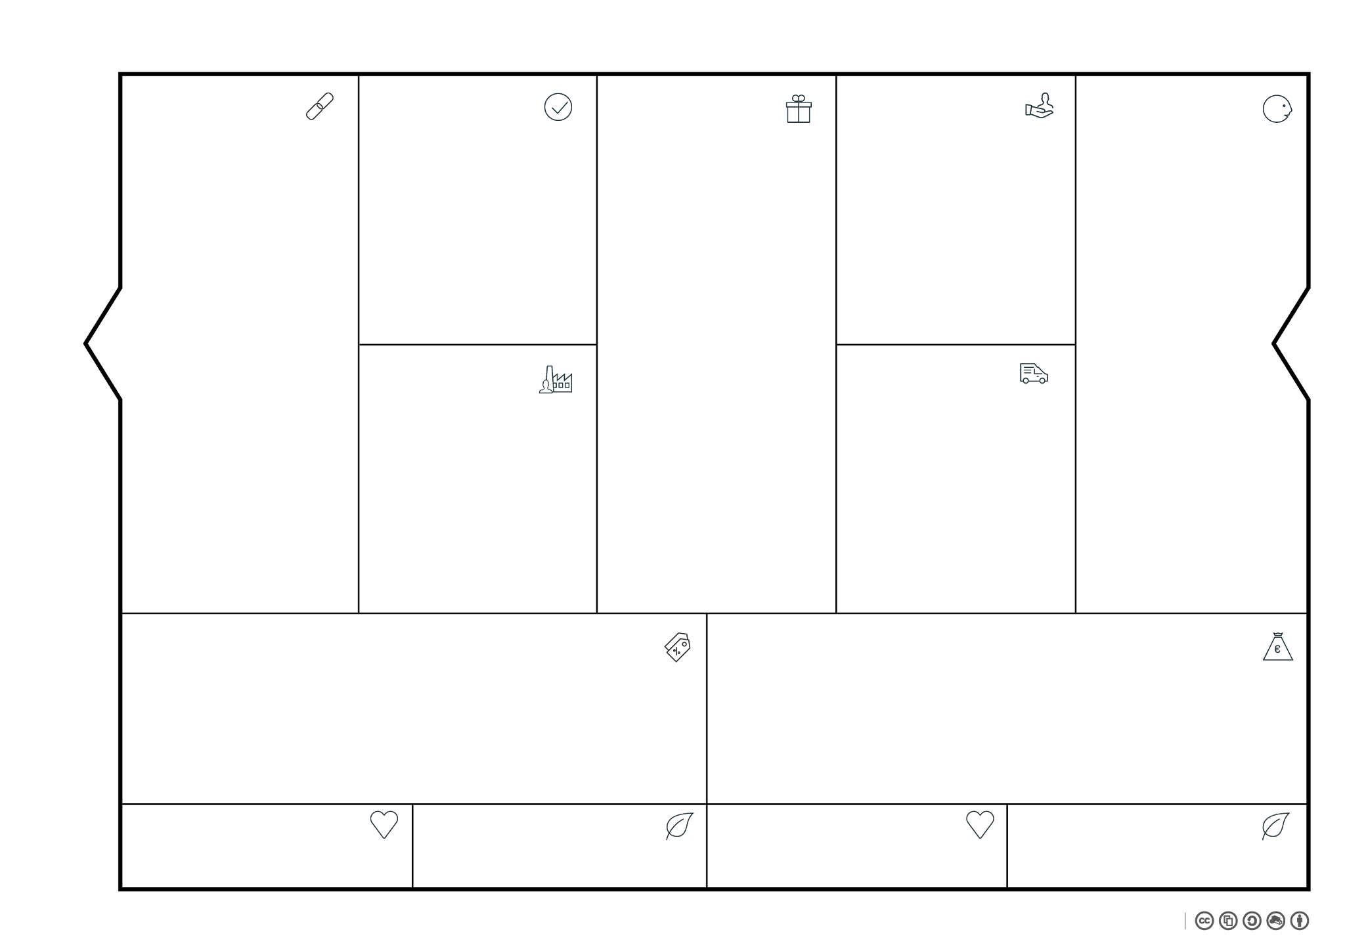
Transport
Package service Pay per package Money
Van lease company Pay per month/day + We have no responsibility for maintenance
Office
Building Rental money Helping a start-up, connections
Prodution
Workshop Pay per product/hours of labor + More work opportunity
Construction market Cheaper products for us More availability/flexibility when out of materials + Exclusive shopping
HR
Gardening company/Housing corporation They install the product/kit for us + They deliver a unique product + They have a skilled/handy workforce
Collect materials
Create the kit
Ship the product to the customer
Service with Customer
Later:
Develop app
Launch app
Service App
Sell Data
Start:
A ‘’dumb’ product that contains and provides water for small garden areas/ balconys.
Easy to install
Cheaper than a ‘pure nature’ solution (wood) but slightly more expensive than the environmentally unfriendly one (plastic)
Sturdy
With the purchase of one product, a customer knows that they have contributed to the recirculation of a difficult product.
Business to consumer:
Concious about materials
Doesn’t want a plastic rainbarrel, but an wooden one is too expensive.
Consumers have a balcony/small gardenspace where they need to water the plants/ground from time to time.
They want an solution that is easily installable
The consumer is the end-user of the product.
The consumer will pay us with money and/or data via a Freemium plan.
Advertisements
- Google adverts
My relationship with the customer is providing a growing solution to a growing problem. I start with a product and follow up with a service where the customer can see the difference the product is making.
This is a more long term relation that just selling the product.
Physical
Office
KvK number
Van for collecting materials
Intellectial property
License App
Data generation
HR
Installer/handyman
Financial
Financial investor
Bank account
App
Product
Office
Other
Subsisdy
Advertisements in app
Sales of the product
Subscription on information
One time purchase of the app for advert-free use.
Customer contact:
Social media, for communication and sharing ideas
Teams/skype/zoom accounts to contact customers about problems/service
A Bol.com/amazon sellers account, for selling and contacting customers.
Networks
App
Backend server maintenance
Materials
Valves
Pipes
Production
Personell
Office
- Rental (all-in)
Other
Savings
Networks
App 75€ * 12
Materials
2€ * piece * customers
12€ * piece * customers
Production
12,5€ * customers
Office
100€ * 12
Other
0€
Networks
App 900€
Materials
2*1000 = 2000€
12*1000 = 12000€
Production
12,5*1000= 12500€
Office
100 * 12 = 1200€
Other
0€
Subsidys
Rainwater clearing
App
Ad revenue
Subscriptions
Premium app
Materials
Product
Subsidys 500€
App
[1] 1€/month 1/10th of the subscriptions
Materials
a piece
Subsidys 500*12 = 6000€
App 711,36€
1*700*12 = 8400€
0,1 * 8400 = 840€
Materials
35*1000 = €35.000
Total: 28.600€
Total: €50.240
People could deem it too small.
It isn’t available in different colors, so it’s not for everybody.
The insides of the expansion tanks could give off some old water.
We add materials to the existing product.
You can show people how aware you are of the rainwater.
Becoming a part of a community that want to view their data more.
Spreading awareness of the increasing amount of water.
Reusing materials that are otherwise difficult to repurpose/cycle.
Providing a (small) buffer for the local rainwater to flow to.
Less strain on the waternet, because people have to use less water from the tap.

